Slide 1
Workshop On 𝐖𝐡𝐲 𝐎𝐎𝐏 𝐢𝐧𝐬𝐭𝐞𝐚𝐝 𝐨𝐟 𝐏𝐫𝐨𝐜𝐞𝐝𝐮𝐫𝐚𝐥 𝐏𝐫𝐨𝐠𝐫𝐚𝐦𝐦𝐢𝐧𝐠
What will You Learn From this Workshop:
𝟏. 𝐍𝐞𝐞𝐝𝐬 𝐨𝐟 𝐑𝐞𝐮𝐬𝐚𝐛𝐥𝐞 𝐂𝐨𝐝𝐞 𝟐. 𝐇𝐨𝐰 𝐭𝐨 𝐑𝐞𝐟𝐚𝐜𝐭𝐨𝐫 𝐚𝐧 𝐄𝐱𝐢𝐬𝐭𝐢𝐧𝐠 𝐂𝐨𝐝𝐞 𝟑. 𝐆𝐨𝐨𝐝 𝐏𝐫𝐚𝐜𝐭𝐢𝐜𝐞 𝐚𝐧𝐝 𝐂𝐨𝐝𝐢𝐧𝐠 𝐂𝐨𝐧𝐯𝐞𝐧𝐭𝐢𝐨𝐧 𝟒. 𝐖𝐡𝐲 𝐭𝐨 𝐀𝐩𝐩𝐥𝐲 𝐎𝐛𝐣𝐞𝐜𝐭 𝐎𝐫𝐢𝐞𝐧𝐭𝐞𝐝 𝐏𝐫𝐨𝐠𝐫𝐚𝐦𝐦𝐢𝐧𝐠 (𝐎𝐎𝐏) 𝟓. 𝐄𝐱𝐩𝐥𝐚𝐢𝐧 𝐚𝐥𝐥 𝐨𝐟 𝐭𝐡𝐞𝐬𝐞 𝐖𝐢𝐭𝐡 𝐚𝐧 𝐫𝐞𝐚𝐥 𝐥𝐢𝐟𝐞 𝐞𝐱𝐚𝐦𝐩𝐥𝐞 𝐚𝐧𝐝 𝐰𝐢𝐭𝐡 𝐁𝐮𝐢𝐥𝐝𝐢𝐧𝐠 𝐚𝐧 𝐀𝐩𝐩𝐥𝐢𝐜𝐚𝐭𝐢𝐨𝐧

Slide 2
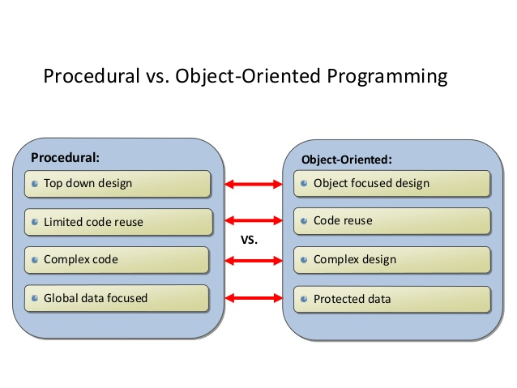

Slide 3
Some Most Important Terms
Good Practices & Coding Conventions
Refactoring & Code smell
Reusable Code

Slide 4
Good Practices & Coding Conventions
1.
// Correct ProductCategory productCategory; // Avoid ProductCategory prodCat;
2 prefix interfaces with the letter I.
public interface IProductCategory {}
public interface ISupplier{}
public interface ICustomer{}
3. use camelCasing for local variables and method arguments , use PascalCasing for class names and method names.
public class UserLog
{
public void Add (Item item)
{
int itemCount = item.Name.Count;
}
}
To Learn More : https://www.dofactory.com/reference/csharp-coding-standards

Slide 5
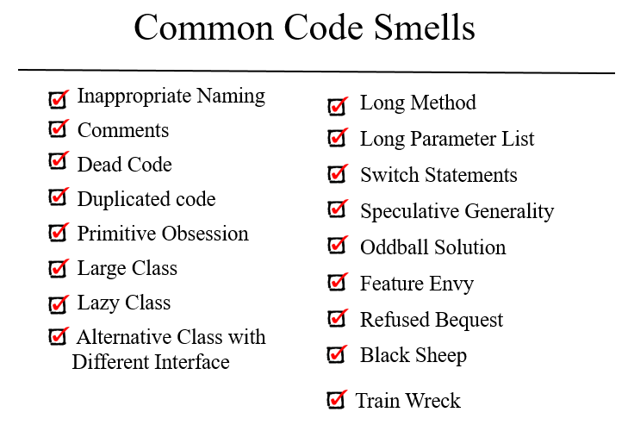

Slide 6
Client Requirements
1. I Need a Scorecard System that will Auto calculate score.
2. I will press just one time and score should be calculated.
3. Must Have to show in following format
Commentry : WOW !!! What a Six !! It's Maximum
Run : 20
Wicket : 0
Over : 2.3 Overs
Total Score : 20/0 2.3 Overs

Slide 7
So Let’s Move onto the Code

